Slide 1
Company Presentation 2022
Karin Ekberg

Slide 2
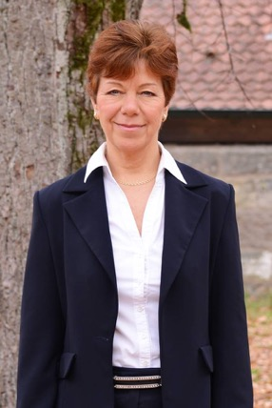
Chose 35 years of professional experience
What makes Leadership & Sustainability unique?
We have 35 years of extensive work experience to improve performance at the corporate strategic level and at the facility level
We stand out from the crowd by our system approach coupled with engineering and manufacturing knowledge and a drive to create change with measurable results
Karin’s expertise are in the following areas, among others:
Sustainability – environment, social, business ethics & corporate governance
Materiality, Business case, Strategy development & implementation
Value chain and business integration of Sustainability
Manufacturing sustainability & Sustainable supply chain management
Karin was awarded the Higg Index Verification Leadership award at the SAC full member meeting in Barcelona, 2019
Here you can find Karin’s profile
CEO Karin Ekberg
©Leadership & Sustainability Karin Ekberg GmbH
Notes:
At Leadership & Sustainability
We promote
Sustainability as Corporate Strategy
Sustainability as Business Model
Sustainability as Leadership quality
You can see our team here.
We cover a broad range of solutions and therefore work in partnerships globally and we work with clients in Europe, Asia and Americas.

Slide 3
About Leadership & Sustainability
3
We have a team of 10 members in Germany and we have around 30 team members in different locations across the world.
Our Expertise, Outreach and Partnerships are global, with primary anchors in Europe, Asia and America.
Our mission is the transformation and embedding of sustainability into business processes over the full value chain.
We are a member of SAC and approved Higg FEM Verifier and Trainer Body as well as SLCP Verifier and Trainer Body.
We are an accredited ZDHC Training Provider.
©Leadership & Sustainability Karin Ekberg GmbH

Slide 4
Project examples and references
©Leadership & Sustainability Karin Ekberg GmbH
Notes:
And now lets turn to products and materials

Slide 5
Overview of our services
Materiality Assessment & Strategies
• Value chain approach
• Materiality assessment over the value chain
• Brand module benchmarking
• Strategy development & Business cases
• Reporting
Supply Chain & Facilities
• Supply chain mapping / strategy
• Higg FEM & SLCP verification
• Chemicals management / „ZDHC protocol“
• Good manufacturing practices and Handbooks
• KPIs & performance improvements
Workshops & Trainings
• Supplier training
• Designer training
• Training on sustainability & environmental impacts
• Training on sustainability strategy
Materials & Products
• Create standards for materials
• Design for environment
• Product portfolio strategy
• Brand policies to include restricted substances & animal welfare etc.
Book your appointment with us now!
©Leadership & Sustainability Karin Ekberg GmbH

Slide 6
L&S Project examples
Strategy & Reporting
Materiality assessment, benchmarking and strategy development for several brands, retailers and manufacturing groups
Workshops about sustainability strategy and ISO 9001/ ISO 14001
Sustainability reports
Carbon footprinting
Risk assessments for products and materials
Product
Study on Microplastics in the oceans
Workshop about materials’ and products’ certifications
Product labels
Read about some of these projects here
©Leadership & Sustainability Karin Ekberg GmbH

Slide 7
L&S Project examples
Supply chain management
Supply chain management: materiality, EH&S guidelines, audit approach, audits
Goals and Action Plans and Handbooks for suppliers on how to improve environmental performance and Higg FEM scores
More than 350 SAC FEM3.0 verifications and EHS audits in multiple locations world-wide
SLCP verifications
Statistics based on Higg FEM self-assessment and verified results of brands’ suppliers
Chemicals management consulting
Product labels
Read about some of our projects here
©Leadership & Sustainability Karin Ekberg GmbH

Slide 8
Higg FEM – Local Experts
Country | No. of Experts | Generalist Verifier | Chemical Specialist Verifier | Trainer
Bangladesh | 1
Germany | 1
India | 3
Indonesia | 1
Pakistan | 1
Romania | 1
Tunisia | 2
Turkey | 2
Vietnam | 6
Please note: For Higg FEM, our verifiers are authorized to perform verifications worldwide according to customer requirements.
©Leadership & Sustainability Karin Ekberg GmbH
Notes:
When you click on the folder records, following overview appears.
You have A&T log, the Higg FEM scheme as well as Higg fSLM/slcp
For today, the first two are specifically in the centre of our attention.
Let‘s begin with the a&t log.

Slide 9
SLCP – Local Experts
Country | No. of Experts | Verifier | Trainer | Approved countries
Bangladesh | 2 |  |  | Bangladesh, Globally
Bulgaria | 1 |  |  | Bulgaria, Macedonia
China | 1 |  |  | China
Germany | 1 |  |  | Germany, Globally
India | 2 |  |  | India
Indonesia | 1 |  |  | Indonesia, Malaysia
Pakistan | 1 |  |  | Pakistan
Portugal | 1 |  |  | Portugal
Romania | 1 |  |  | Romania
Tunisia | 1 |  |  | Kenya, Mauritius, Madagascar, Morocco, Tunisia
Turkey | 2 |  |  | Turkey
Vietnam | 3 |  |  | Vietnam
©Leadership & Sustainability Karin Ekberg GmbH
Notes:
When you click on the folder records, following overview appears.
You have A&T log, the Higg FEM scheme as well as Higg fSLM/slcp
For today, the first two are specifically in the centre of our attention.
Let‘s begin with the a&t log.

Slide 10
Higg BRM – Our services
We are now a verifier body for Higg BRM with 2 BRM verifiers
Brands and retailers of all sizes can use Higg BRM to measure environmental and social impacts of their value chain
Leadership & Sustainability provides verification to Higg Brand and Retail Module (BRM) users
We offer both on-site and off-site verifications and support you with your self-assessment
©Leadership & Sustainability Karin Ekberg GmbH
Notes:
When you click on the folder records, following overview appears.
You have A&T log, the Higg FEM scheme as well as Higg fSLM/slcp
For today, the first two are specifically in the centre of our attention.
Let‘s begin with the a&t log.

Slide 11
Official ZDHC Accredited Training Provider
ZDHC is the acronym for Zero Discharge of Hazardous Chemicals and started in 2011 as a response to the Greenpeace Detox campaign
Since April 2020 Leadership & Sustainability is an accredited ZDHC training provider
We offer both face-to-face as well as webinar trainings and support you with your effort to reduce your chemicals footprint
©Leadership & Sustainability Karin Ekberg GmbH

Slide 12
Our Free Webinars
Recordings & Presentations:
How to make your brand & retail business more sustainable with Higg BRM
Supply Chain Management Program for Social Performance
Towards the Supply Chain Laws – Are you prepared?
Traceability and Supply Chain Mapping
Social and Environmental Risk Assessment and Strategy
Operations & Logistics – Environment
Supply Chain Management Program for Environmental Performance
Climate Change & Science-Based Targets
©Leadership & Sustainability Karin Ekberg GmbH
Notes:
I would like to also recommend some of our previous webinars, amongst others from our verification trail and more.

Slide 13
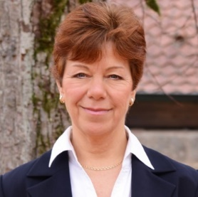
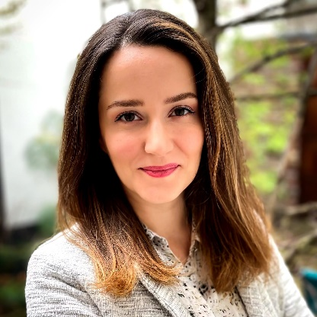
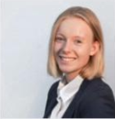
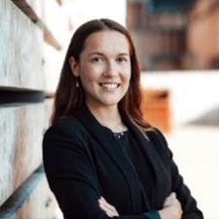
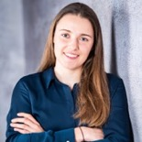
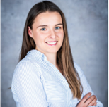
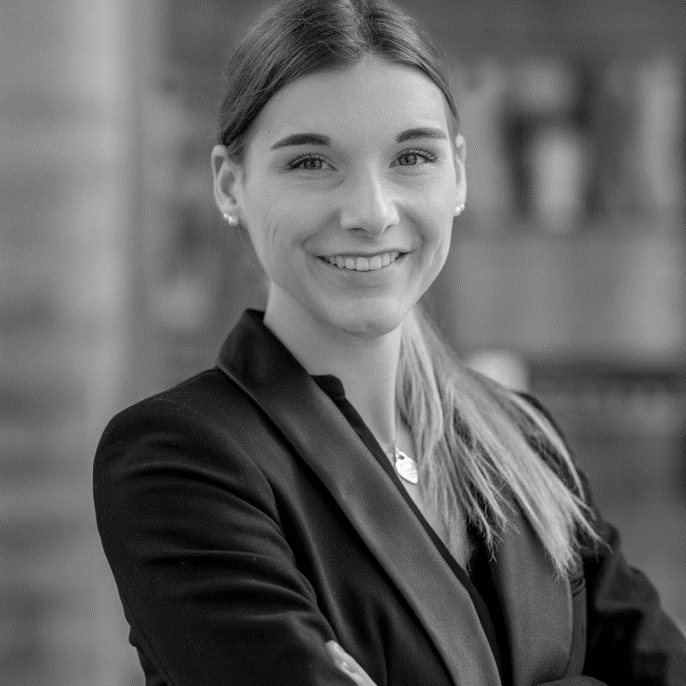
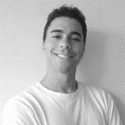
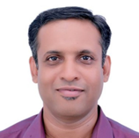
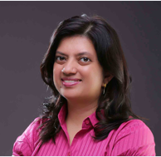
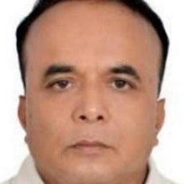
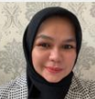
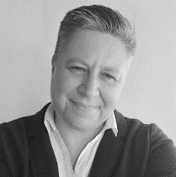
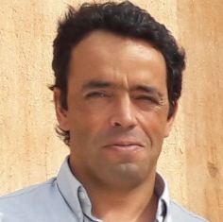
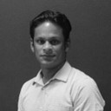
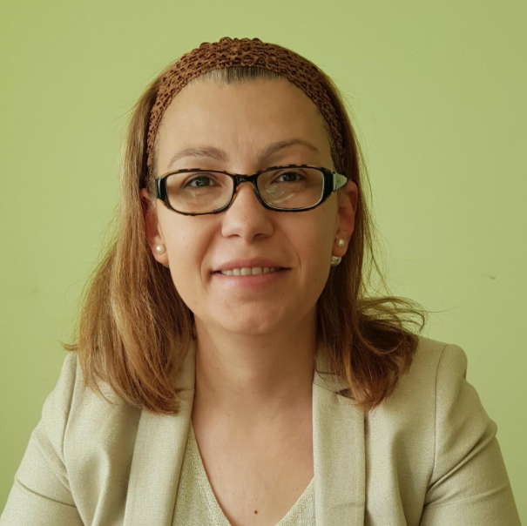
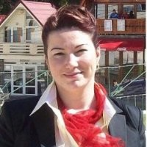
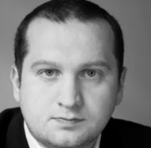
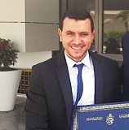
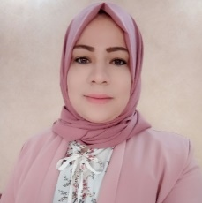
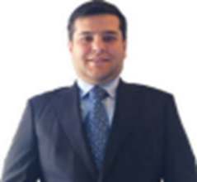
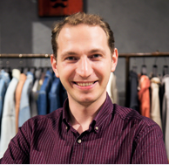
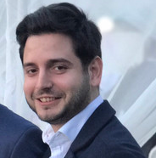
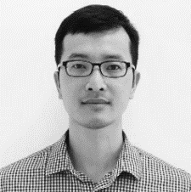
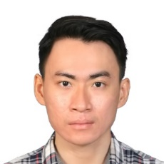
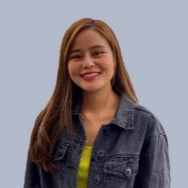
Contact
Visit our Website:
www.leadership-sustainability.com
E-Mail us:
Karin.Ekberg@Leadership-Sustainability.com
Call us:
Mobile: +49 (151) 461 70 184
Sign up to our newsletter or follow us on:
Newsletter
LinkedIn
Twitter
YouTube
Notes:
One slide about our company and here you see our team
CLICK

